Slide 1
Meet Minder Design
Michael Mark
William D. Bodeis
Irina Gorlik
Samuel A. Grossmeyer
Joseph G. Maes

Slide 2
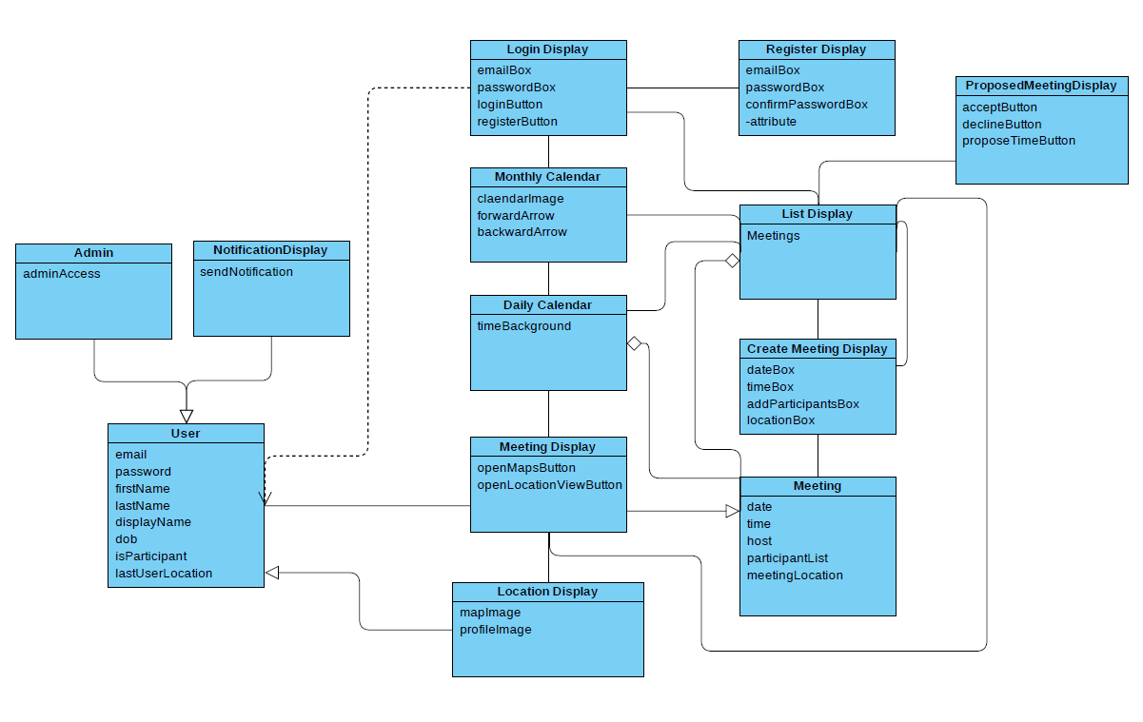
Domain Class Model

Slide 3
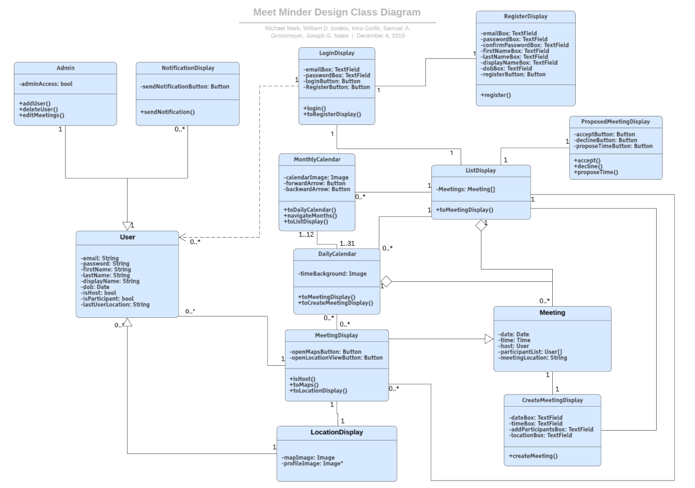
Design Class Model

Slide 4
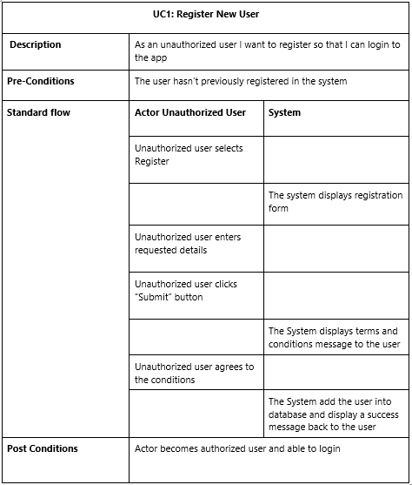
UC1: Register New User

Slide 5
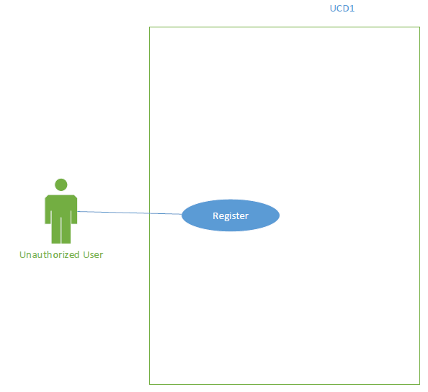
UML Diagram UC1

Slide 6
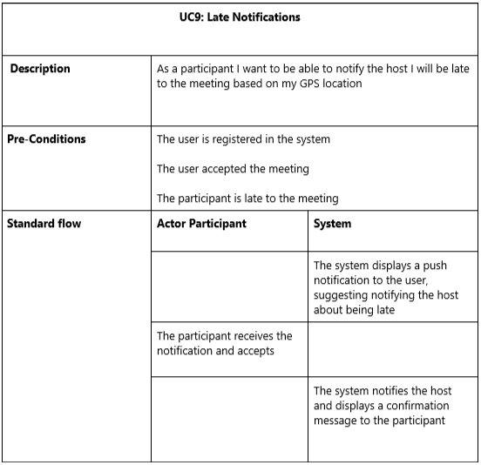
UC9: Notify Host

Slide 7
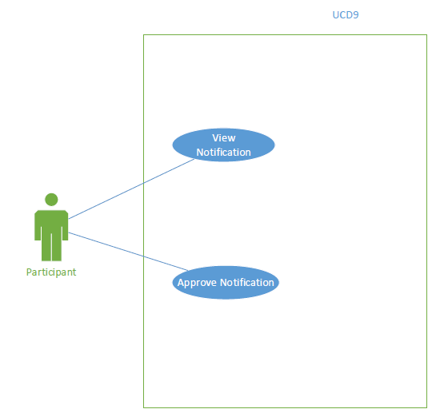
UML Diagram UC9

Slide 8
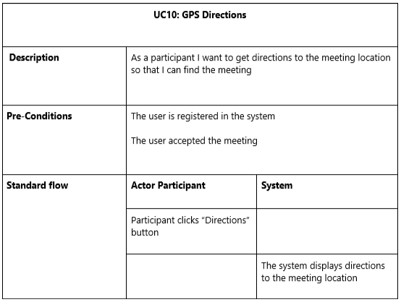
UC10: GPS Directions

Slide 9
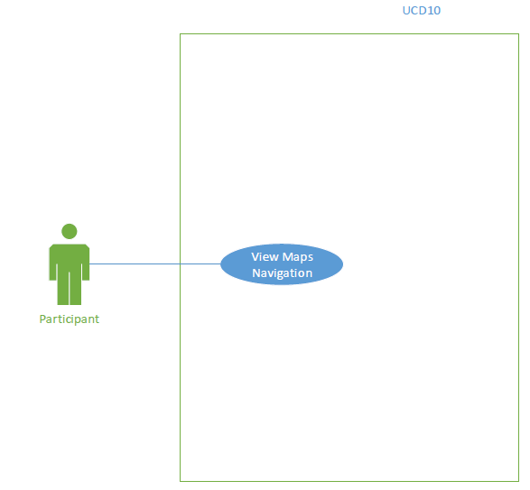
UML Diagram UC10

Slide 10
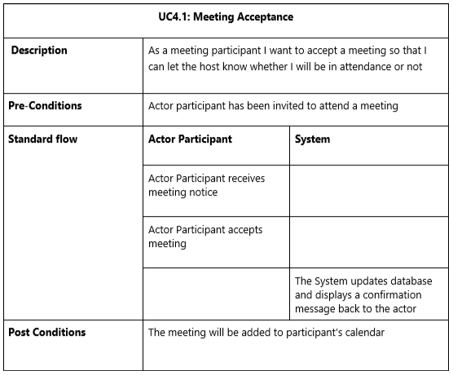
UC4: Meeting Acceptance

Slide 11
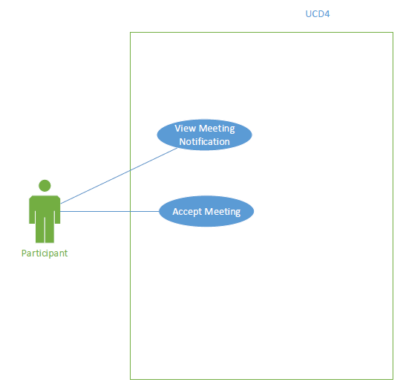
UML Diagram UC4

Slide 12
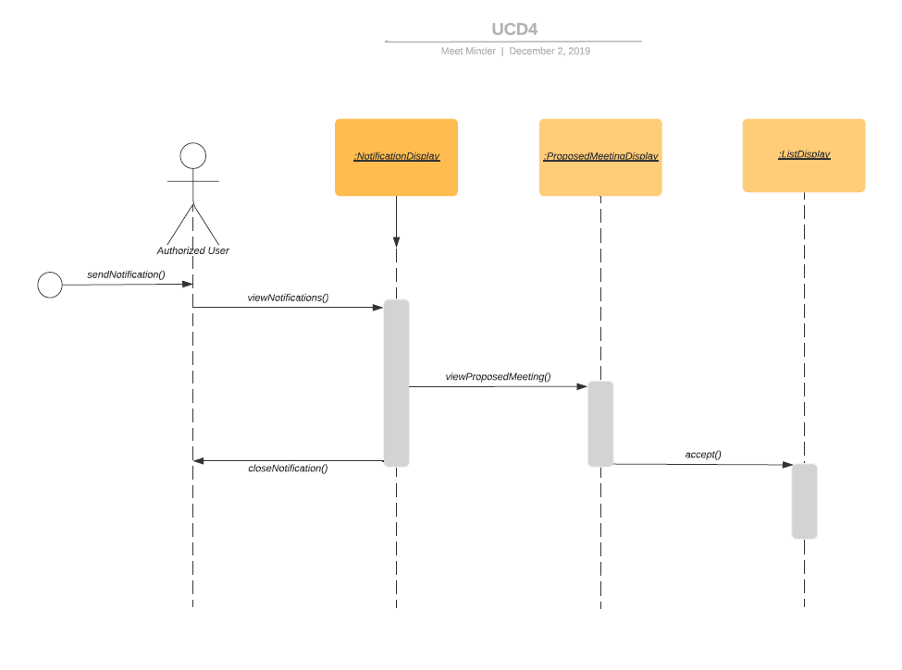
Sequence Diagram UC4

Slide 13
GUI Slides
To Adobe XD!

